Slide 1
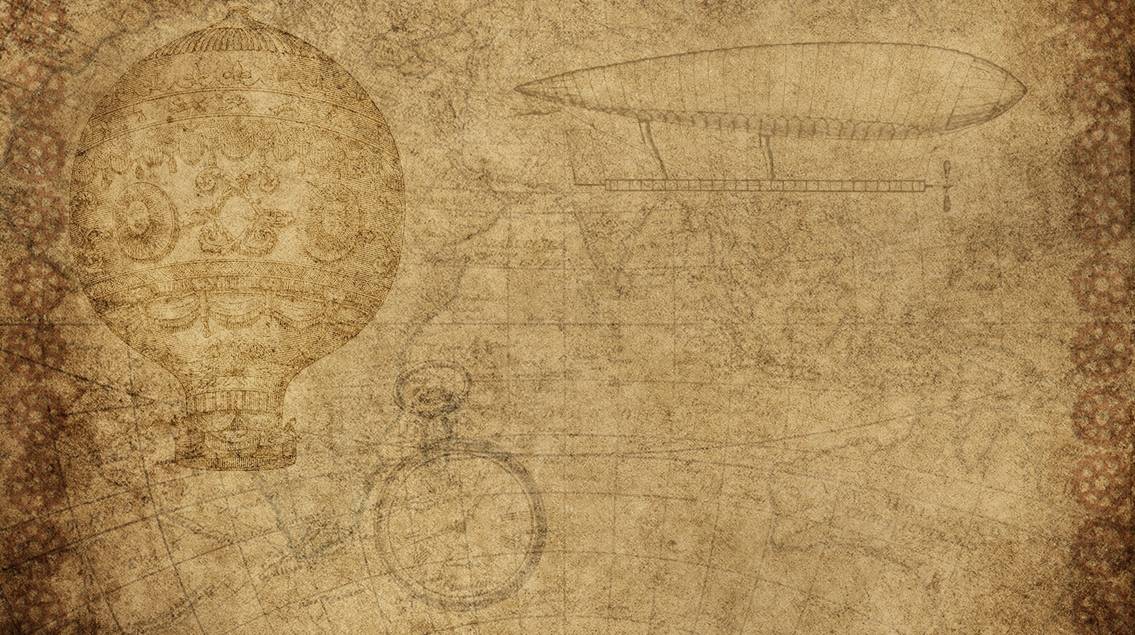

Analyze Telemetry to better anticipate problems and achieve goals.
Mahonrry barrios, Rodrigo concha, and scott donner.

Slide 2

Introduction
Outlier detection.
Means and standard deviation.
Instrument and alert on undesired outcomes.
Problems for non using Non-Gaussian distribution.
Netflix (Case Study)
Anomaly detection techniques.
Advanced anomaly detection (Case Study)

Slide 3

Outlier detection.
Detecting abnormal running conditions.
Identifying the norm.
Defining normal behavior.
Benefits of outlier detection.

Slide 4

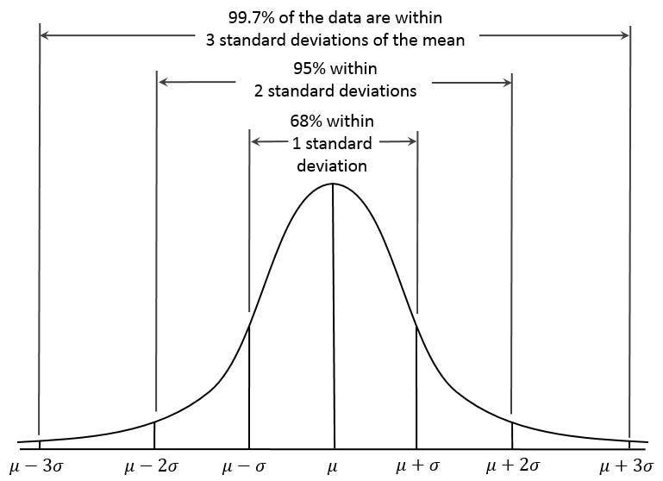
Means and standard deviation.
Simple way to analyze production metrics.
Detect when the metric is significantly different than its norm.
Better alerts are increased by the signal-to-noise ratio

Slide 5


Instrument and alert on undesired outcomes.
Four precursor to a production incident:
Application level.
OS level.
Database level.
Network level.

Slide 6
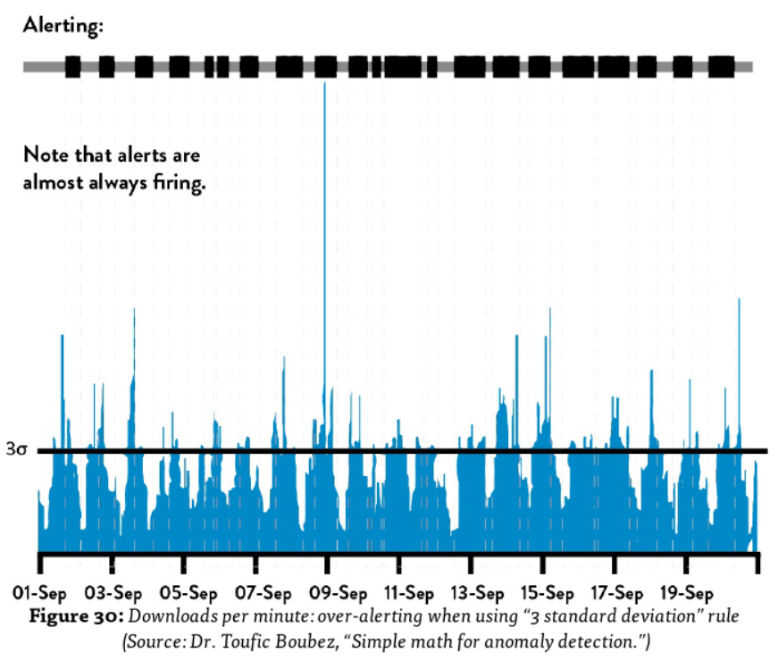
Problems for non using Non-Gaussian distribution.
We could get undesired alarms.
Properties associated with standard deviation does not apply.
Over alerting can causes operation engineers be woken up in the middle of the night.
Software components failures leads to poor delivery services.

Slide 7
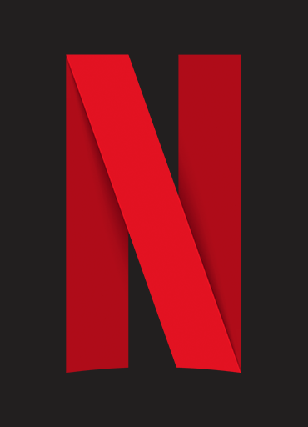
Netflix (Case Study)
In 2012, Netflix developed a tool that is called SCRYER with the purpose of increase quality and address some issues with Amazon auto scaling.

Slide 8
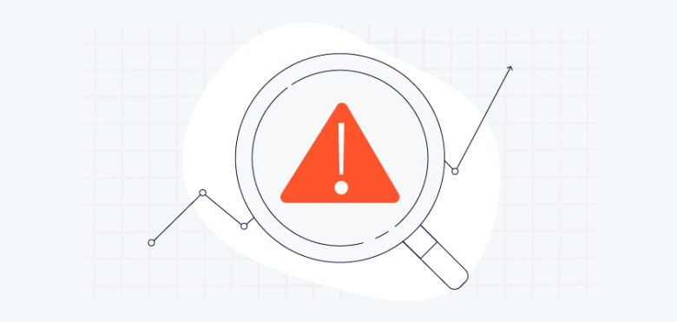
Anomaly detection techniques.
Anomaly detection.
Smoothing.
Fast fourier transformations (FFT).

Slide 9
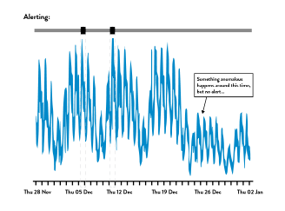
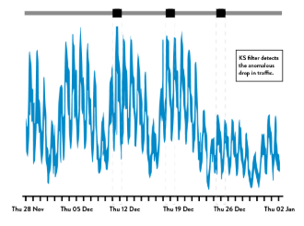
Advanced anomaly detection (Case Study)
Monitorama (2014): Dr. Toufic Boubez and the power of using anomaly detection techniques (Komogorov-Smirnov).
Top Figure: number of transactions per minute at an e-commerce site using 3 standard deviation rule.
Non-parametric techniques are great for Operations data.
Bottom Figure: Same data set as the Top Figure with the K-S filter applied.

Slide 10
CONCLUSION
Analyze production telemetry in order to find and fix problems earlier than ever.
Find failure signals to act upon, create a safer system of work, and increase ability to achieve goals.
Case studies: Netflix and Advanced Anomaly Detection.

